Slide 1



Copilot-Powered Productivity in Power BI
Scott Shearer, MVP, MCT
Scott J Shearer, LLC

Slide 2
Session Description
Copilot-Powered Productivity in Power BI
  In this dynamic demo-rich session, discover how Copilot can elevate your data experience—from accelerating report creation to empowering deeper insight generation through natural language interaction
  Whether you're a seasoned Power BI developer or just getting started, this session will unpack practical Copilot use cases that transform the way you build, analyze, and share data stories.

Slide 3



Scott Shearer
Microsoft MVP
Microsoft Certified Trainer
LinkedIn
Scott@M365Scott.com
YouTube
Scott J Shearer LLC

Slide 4









Please thank our sponsors

Slide 5


Submit session feedback

Slide 6
What is Copilot in Power BI?
AI-powered assistant in Power BI
Capabilities:
Ask questions
Generate visuals
Assist with DAX
Provide insights
Notes:
Explain how Copilot works and its integration in Power BI. Highlight its benefits and show a simple demo to illustrate its capabilities.
Mini demo: 'Summarize sales performance by region'

Slide 7
Copilot in Power BI
Integration:
Power BI Desktop & Service
Benefits:
Saves time
Accessible analysis
Boosts productivity

Slide 8
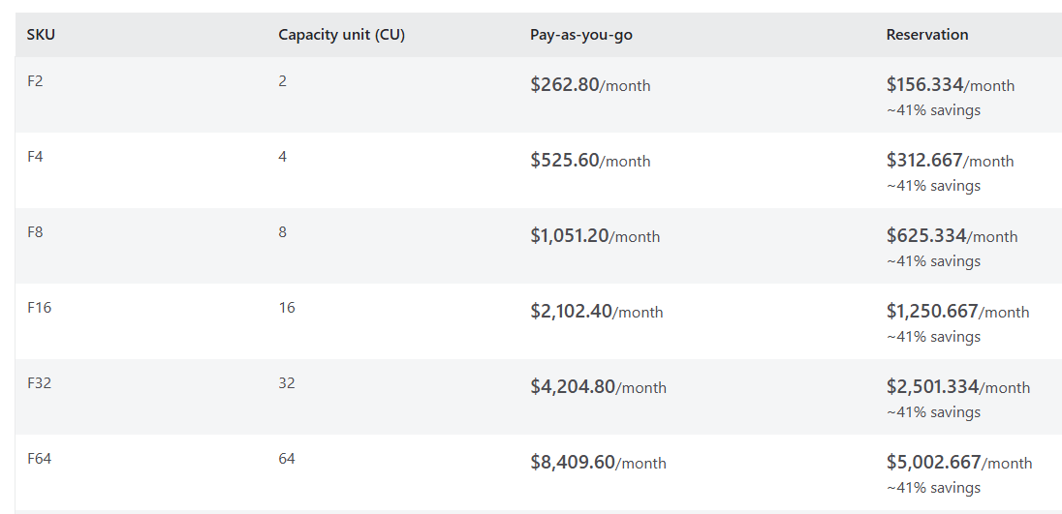
License Requirement
A Fabric F2 or higher capacity is required
A workspace created in a Premium Capacity or Fabric Capacity

Slide 9
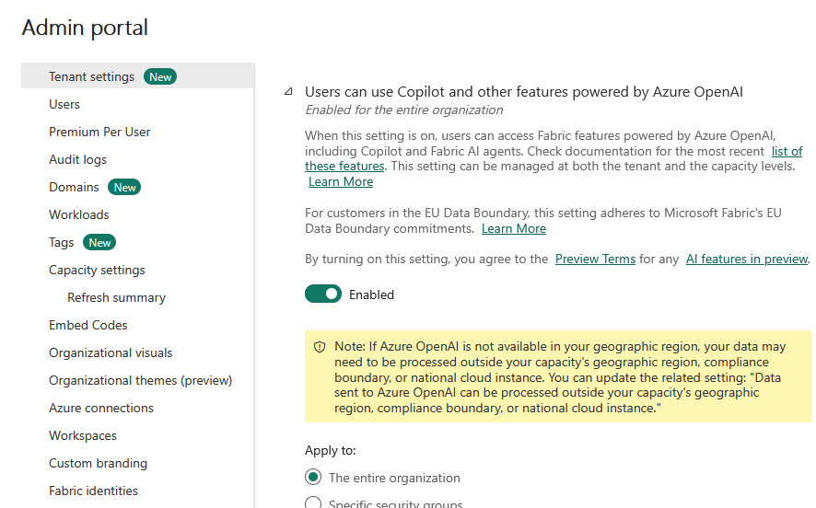
Admin Portal Configuration
Copilot features must be enabled in the Admin Portal
Enable Fabric Copilot for Power BI - Power BI | Microsoft Learn
Notes:
Enable Fabric Copilot for Power BI - Power BI | Microsoft Learn

Slide 10
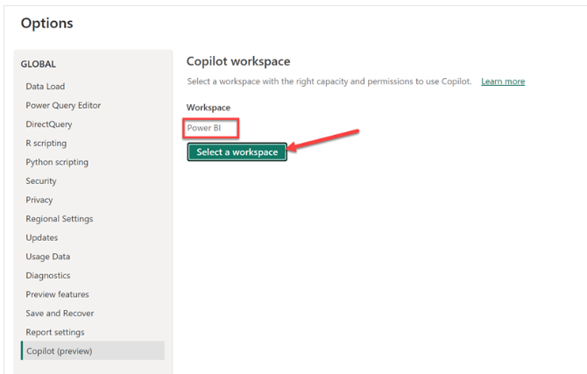
Using Copilot in the Power BI Desktop App
To use Copilot in the Power BI service, you need to ensure that reports are located in a workspace in the right capacity
The workspace must be in either Premium Power BI (P1 and above) or paid Fabric (F2 and above) capacity.
A Copilot workspace must be selected in options/settings to use Copilot
Preview Features must be enabled
Other Copilot features must be enabled in the Power BI app
Copilot workspace must be selected

Slide 11
Copilot Integration Points
Stand Alone App
Copilot pane
DAX Query Window/Quick Measures

Slide 12
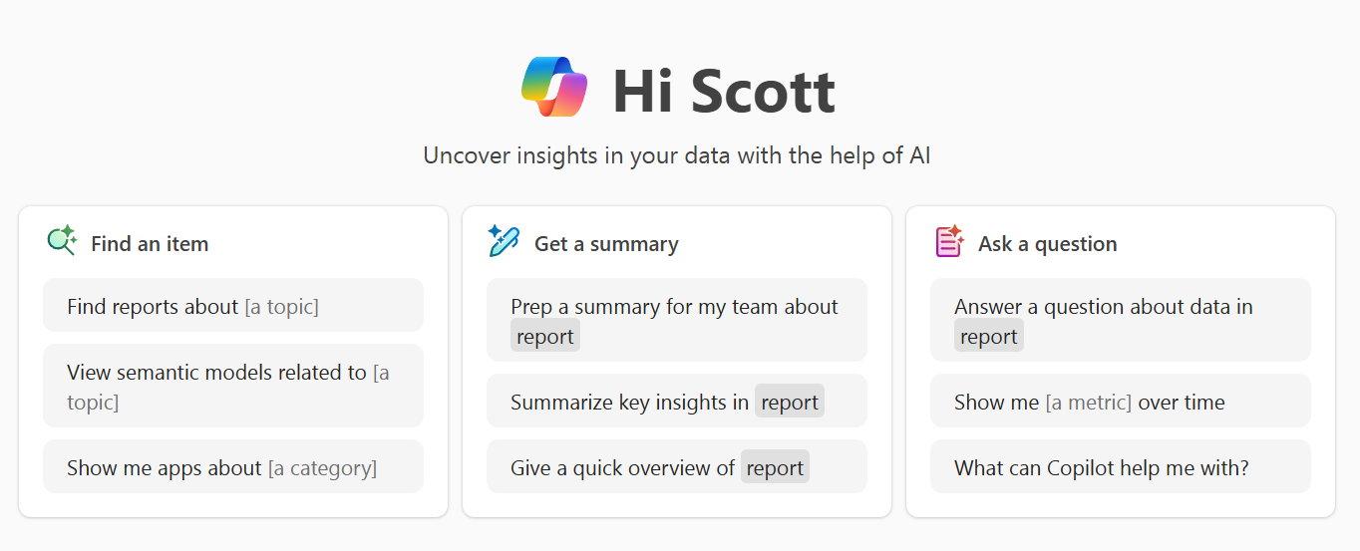
Stand Alone App
Finds and answers questions about any report, semantic model, and Fabric data agent o which you have access
Different from the Copilot pane
  Copilot pane only answers questions about the report you currently have open

Slide 13
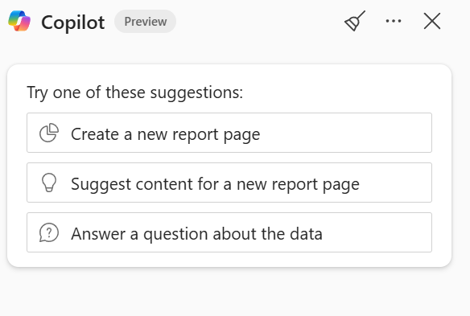
Copilot Pane
Insert screen shot

Slide 14
Copilot Pane
Suggest content for new reports based on the semantic model.
Create report pages by identifying relevant tables, fields, and visuals.
Summarize the semantic model to better understand the data structure.
Generate insights like: "Summarize this page using bullet points.”
Generate narrative visuals summarizing pages or specific charts.
Write DAX queries by describing the desired calculation.
Add descriptions to semantic model measures for better documentation

Slide 15
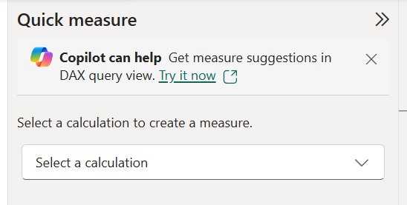
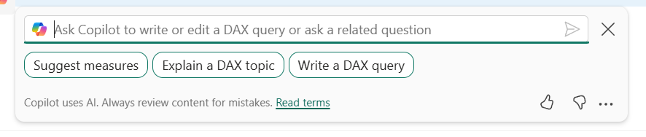
DAX Query Window/Quick Measures
Generate descriptions for measures (model view)
Highlight a measure in DAX view and ask it to explain
Create measure – natural language
Alter an existing measure
Ask DAX Questions
And more…

Slide 16

Steps for Using Copilot in Power BI
Enable features in tenant
Turn on preview features in app
Prepare your data

Slide 17

Demo

